Slide 1
A kötőszöveti meszesedés terápiájának új útjai
Váradi András
MTA TTK
Enzimológiai Intézet

Slide 2
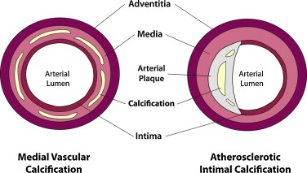
Finom szabályozási mechanizmusok gondoskodnak arról, hogy a meszesedés, a hidroxiapatit-képződés a puha szövetekben ne indulhasson meg. Ismert azonban számos olyan pathológiás állapot, betegség, amelyeket a kötőszövetek meszesedése jellemez, ez érintheti a bőrt, a vesét, a szemet. Legsúlyosabb következményként az artériák középső rétegét képező simaizom rostok alkotta struktúrában alakul ki hidorxiapatit lerakódás, aminek következtében az érfal elveszíti rugalmasságát. Ez pedig nagyon súlyos keringési betegségekhez vezet.

Slide 3
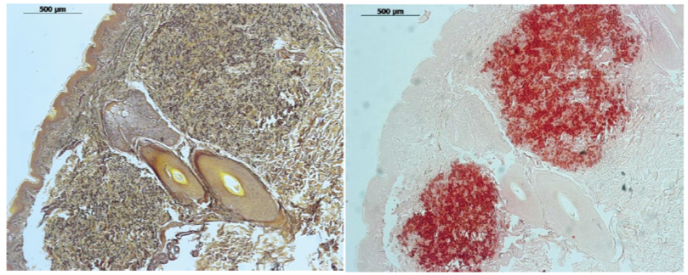
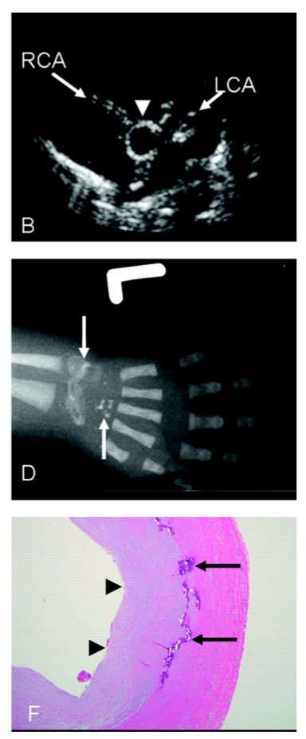
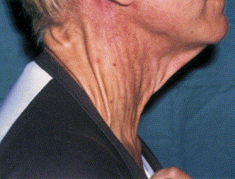
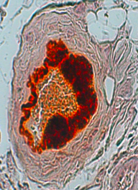
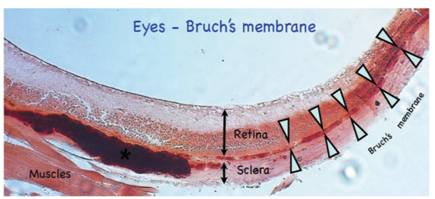
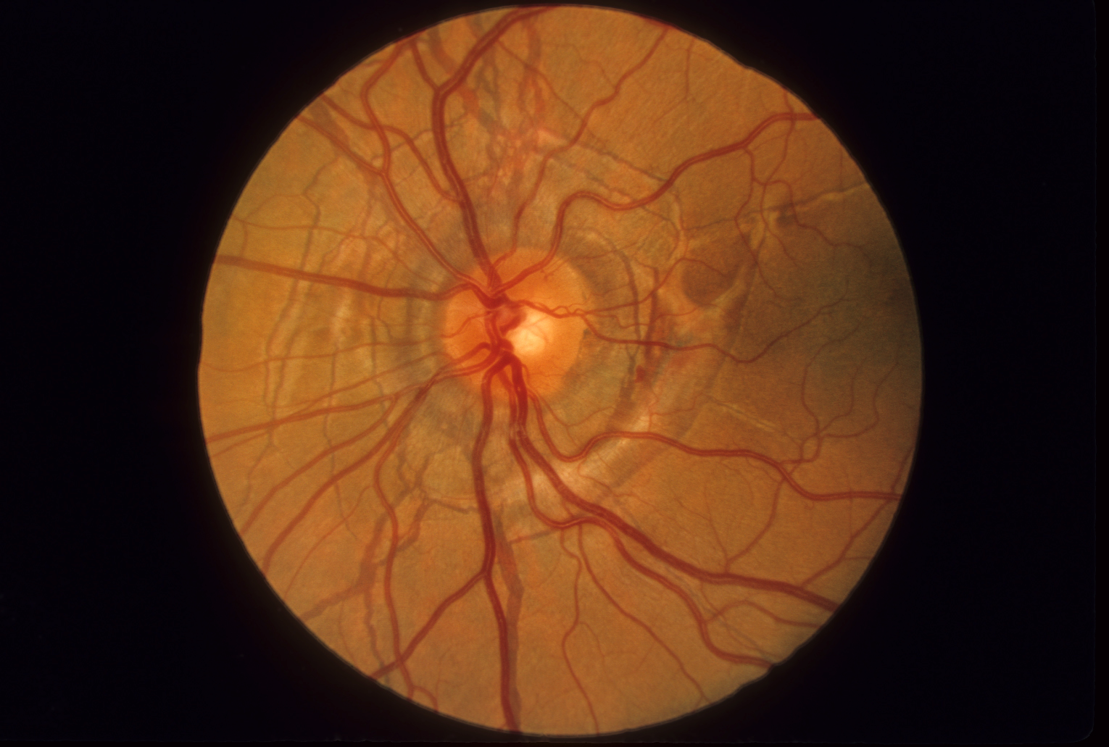
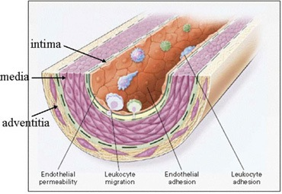
Soft tissue calcification: genetic “models”
Pseudoxanthoma elasticum Generalized Arterial Calcifcation in Infancy
(PXE) 2000 (GACI) 2006
Coronary artery of a 6 weeks old GACI patient, post mortem
PXE and GACI represent the two extremes of the clinical spectrum

Slide 4
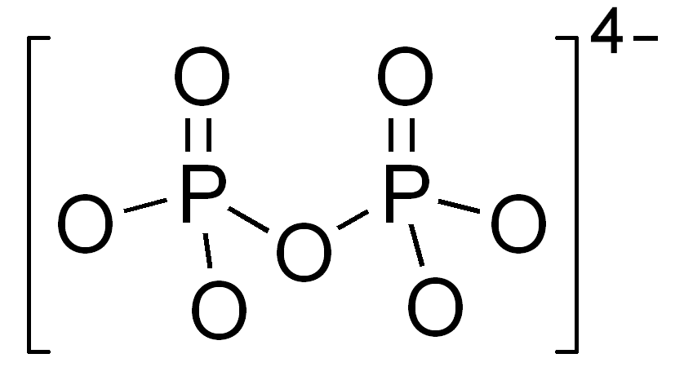
from the review: Li Q, Arányi T, Váradi A,
Terry SF, Uitto J. J Invest Dermatol. 2016
RESEARCH
TOWARD
THERAPY
Plasma PPi is low in PXE and in GACI

Slide 5
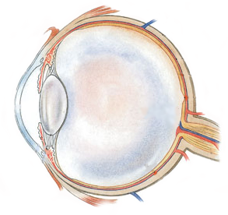
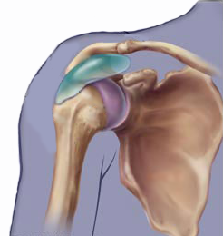
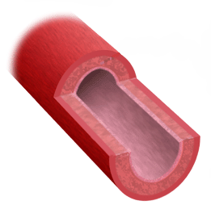
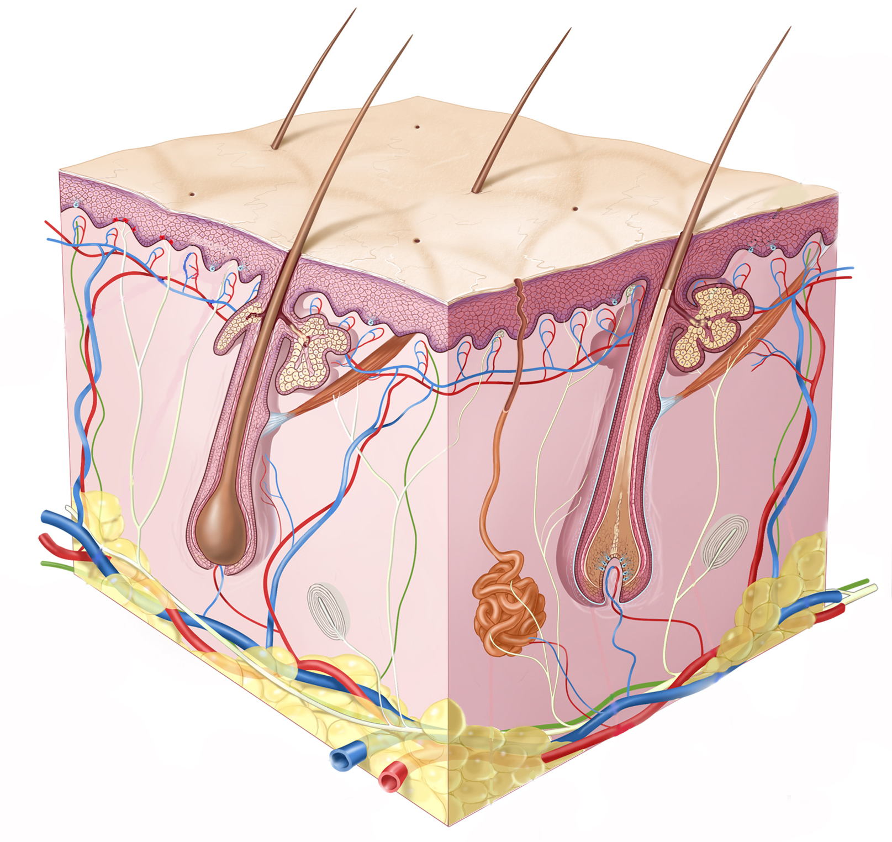
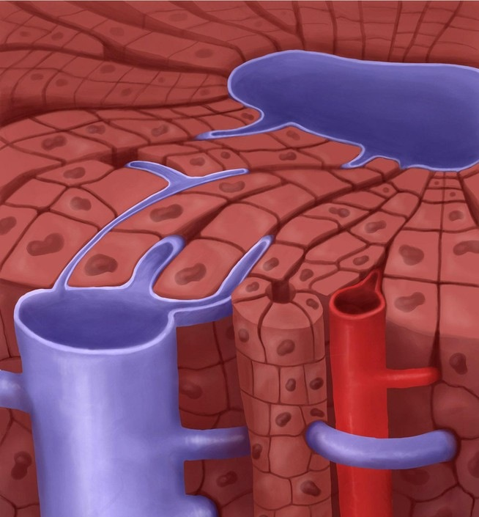
ABCC6, a long MRP
An organic aninon transporter (Iliás et al, 2002)
Large number of disease-causing missense mutations
Approx. 75% of patients are with at least one missense allele
AIMS
PXE
To identify mutations with preserved
transport function but with challenged
cellular localization
These mutations are candidates for
pharmacological correction
…..Allele-specific therapy…..
Metabolic disease

Slide 6
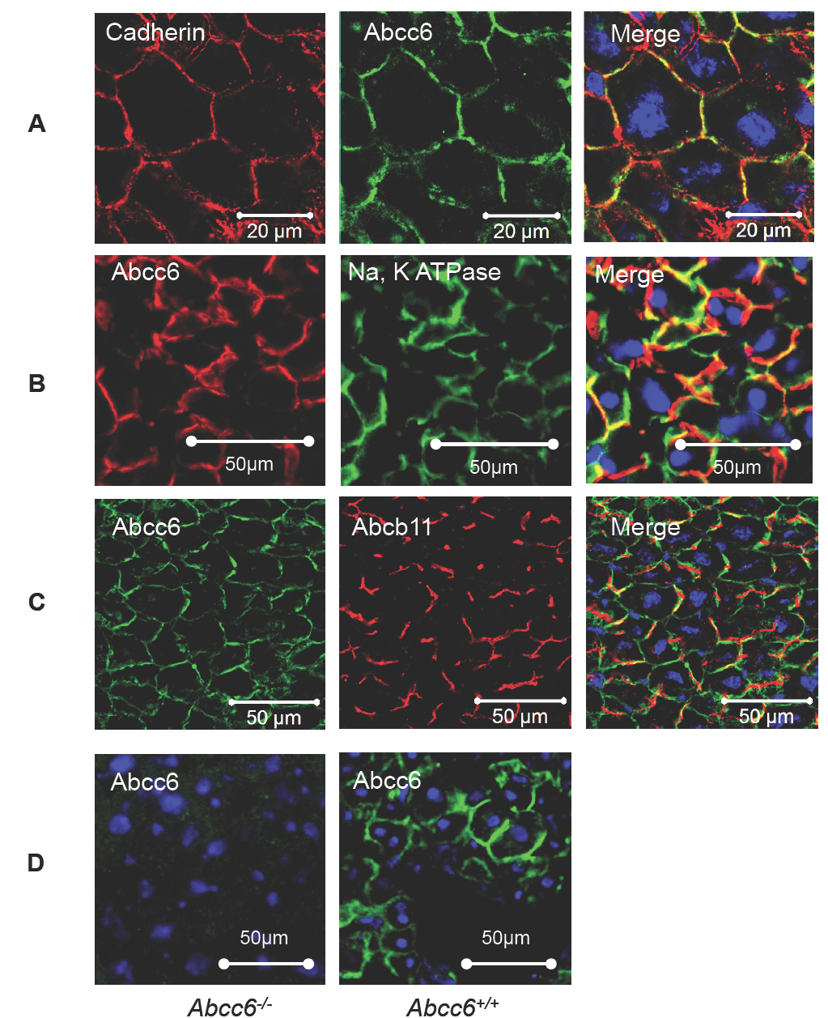
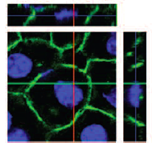
Pomozi et al, (2013)
Circulation Research
Frozen mouse and human liver
sections
Colocalization with plasma
mebrane marker cadherin,
with basolateral PM marker
Na,K ATPase.
Anti-Abcb11 and the anti-Abcc6
antibodies clearly delineated
the canalicular and the
sinusoidal compartments,
respectively.
Confocal
image:
Clear basolateral
plasma membrane
localization

Slide 7
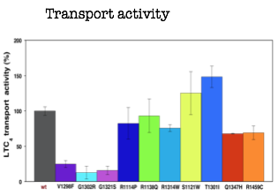
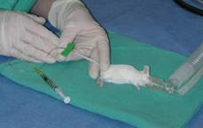
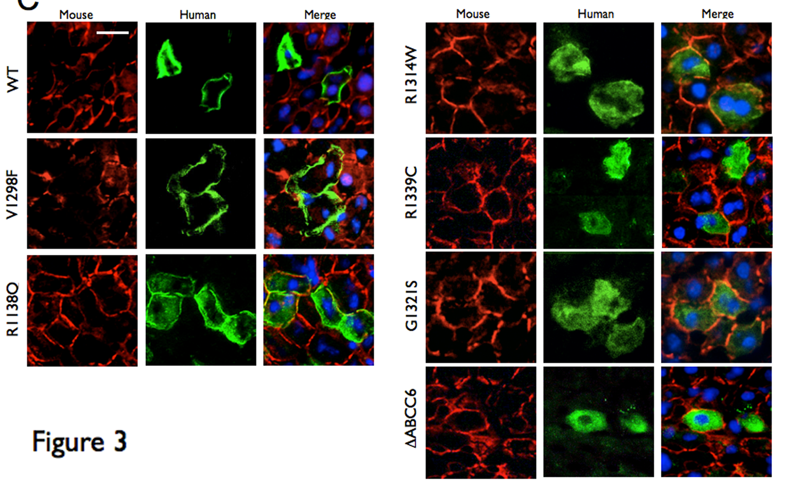
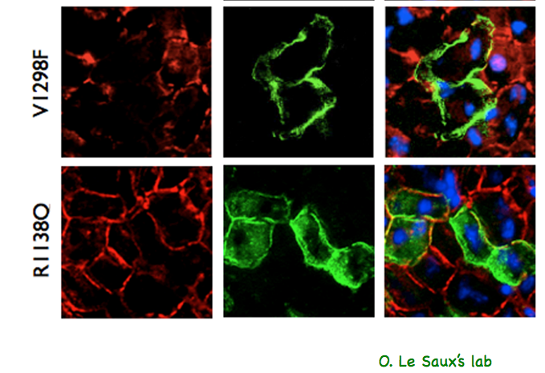
Cellular localization of hABCC6 mutants in mouse liver
O. Le Saux’s lab

Slide 8
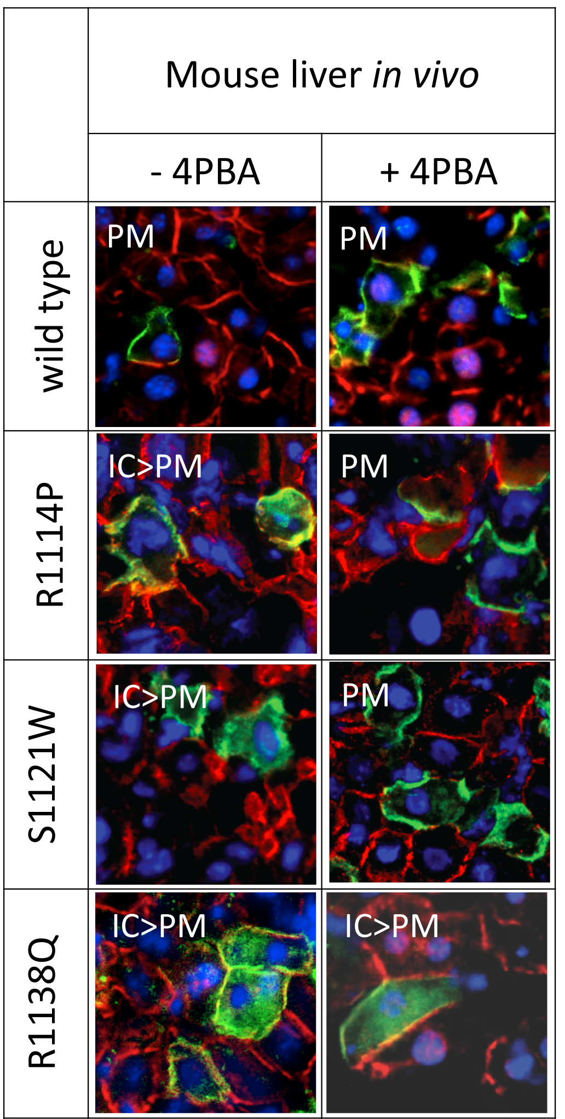
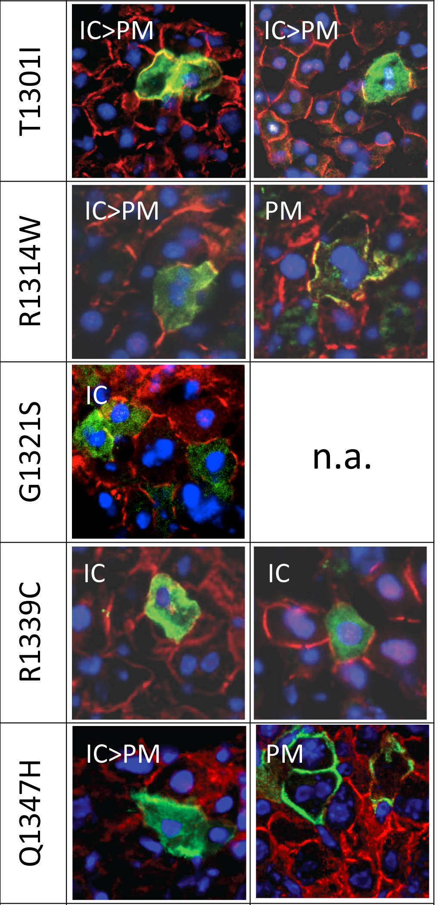
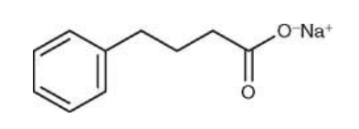
Improved plasma membrane localization
Pomozi et al (2014)
J.Invest.Dermatol.
4-PBA
Approved by FDA for clinical use in urea cycle disorders and thalassemia.
A chemical chaperon inducing Hsp70 and Hsp90 and inhibiting Hsc70 and Aha1.

Slide 9
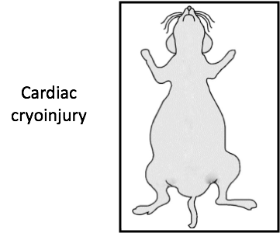
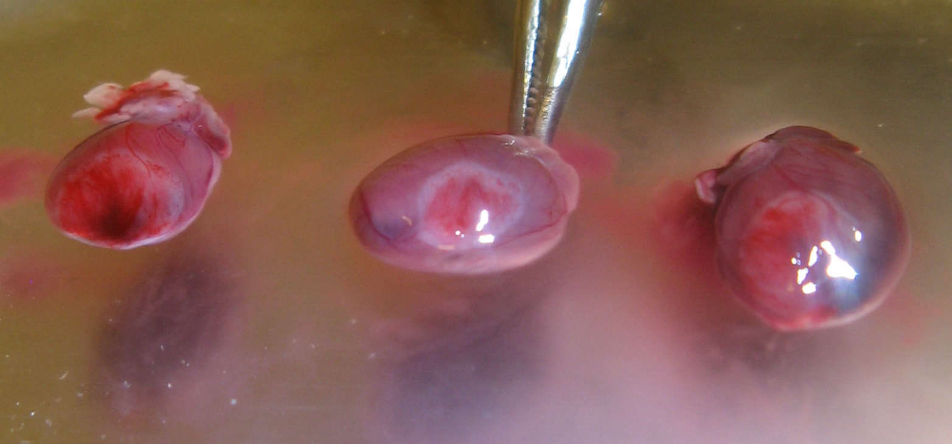
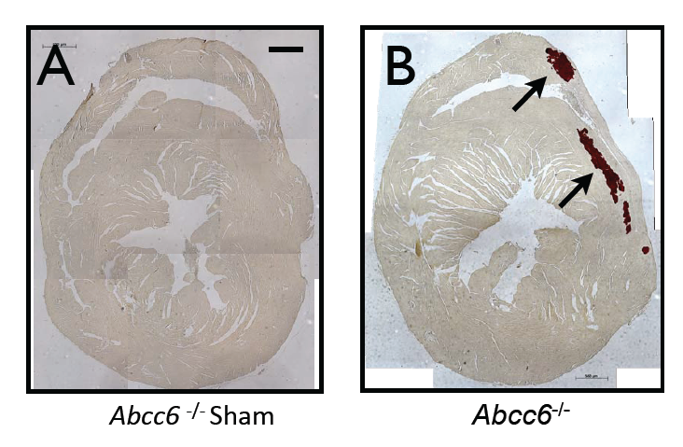
Fast approach to test pysiological function
Dystrophic Cardiac Calcification DCC
2 3 4

Slide 10
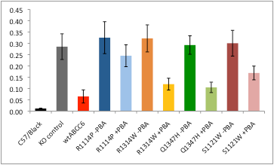
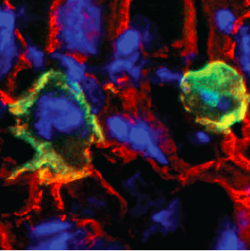
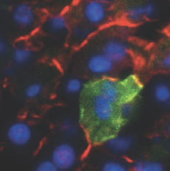
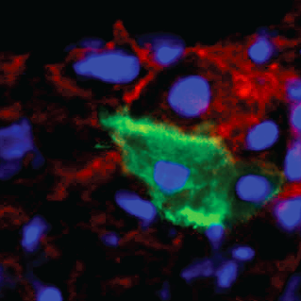
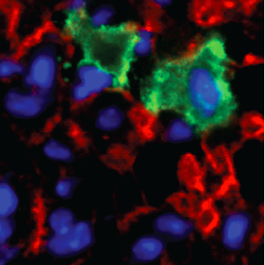
Can calcification be rescued?
no
ABCC6
ABCC6
wt
- 4-PBA
R1114P
R1314W
Q1347H
S1121W
R1114P
Ca [mg/dl/g tissue]
R1314W
Q1347H
Abcc6+/+
Abcc6-/-
4-PBA
-
-
-
-
-
-
-
n=4
n=4
n=5
n=6
n=8
n=9
n=15
S1121W
Pomozi et al (2017)
J.Invest.Dermatol.

Slide 11
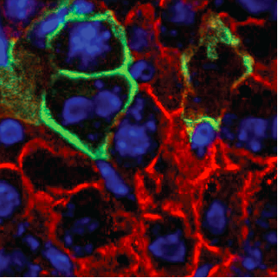
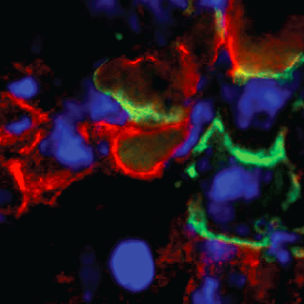
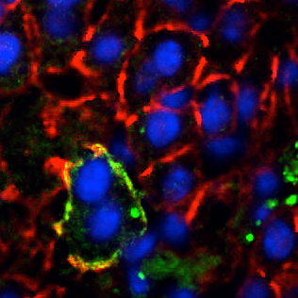
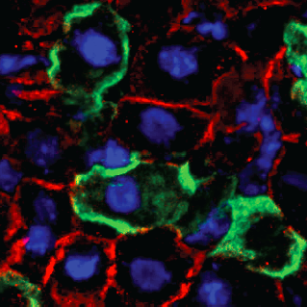
Can calcification be rescued?
no
ABCC6
ABCC6
wt
- 4-PBA
+ 4-PBA
R1114P
R1314W
Q1347H
S1121W
R1114P
Ca [mg/dl/g tissue]
R1314W
Q1347H
Abcc6+/+
Abcc6-/-
4-PBA
-
-
-
-
+
-
+
-
+
-
+
n=4
n=4
n=5
n=6
n=11
n=8
n=10
n=9
n=11
n=15
n=11
S1121W

Slide 12
Can calcification be rescued?
YES!
no
ABCC6
ABCC6
wt
- 4-PBA
+ 4-PBA
R1114P
R1314W
Q1347H
S1121W
P<0.05
p<0.05
p<0.005
p<0.05
R1114P
Ca [mg/dl/g tissue]
R1314W
Q1347H
Abcc6+/+
Abcc6-/-
4-PBA
-
-
-
-
+
-
+
-
+
-
+
n=4
n=4
n=5
n=6
n=11
n=8
n=10
n=9
n=11
n=15
n=11
S1121W
Pomozi et al (2014 and 2017)
J.Invest.Dermatol.

Slide 13
SUMMARY/1
We can “cure” calcification in mice!
We developed a suitable preclinical model.
75% of PXE patients are with at least one missense allele!
What I showed here might be the basis of a feasible allele-specific therapeutic solution in PXE (“repurposing” use of PBA).
Good news
Based on our results a clinical trial is planned in Angers, France PXE Center

Slide 14
A TRIVIAL SOLITION
is to normalize plasma PPi
level:
ORAL PPi SUBSTITUTION
as therapy?
Plasma PPi is low in PXE and in GACI
from the review: Li Q, Arányi T, Váradi A, Terry SF, Uitto J.
J Invest Dermatol. 2016 136: 550-6

Slide 15
Oral bioavailability
Is PPi substitution therapy possible?
As life-long treatment is necessary, the preferred route of administration would be oral.
HOWEVER
„…pyrophosphate has to be injected as it is ineffective orally
because of hydrolytic destruction within the gut…“
Orriss, IR., Arnett, TR., Russell, RG. Pyrophosphate: a key inhibitor of mineralisation. Curr Opin Pharmacol. 28, 57-68 2016.
„However pyrophosphate is not active when given orally…“
Francis, MD, Russell R. G. G and Fleisch,H. Diphosphonates Inhibit Formation of Calcium Phosphate Crystals in vitro and Pathological Calcification in vivo Science, 165, 1264-1266 1969
NO!

Slide 17
Fast approach to test pysiological function
Dystrophic Cardiac Calcification DCC
2 3 4

Slide 18
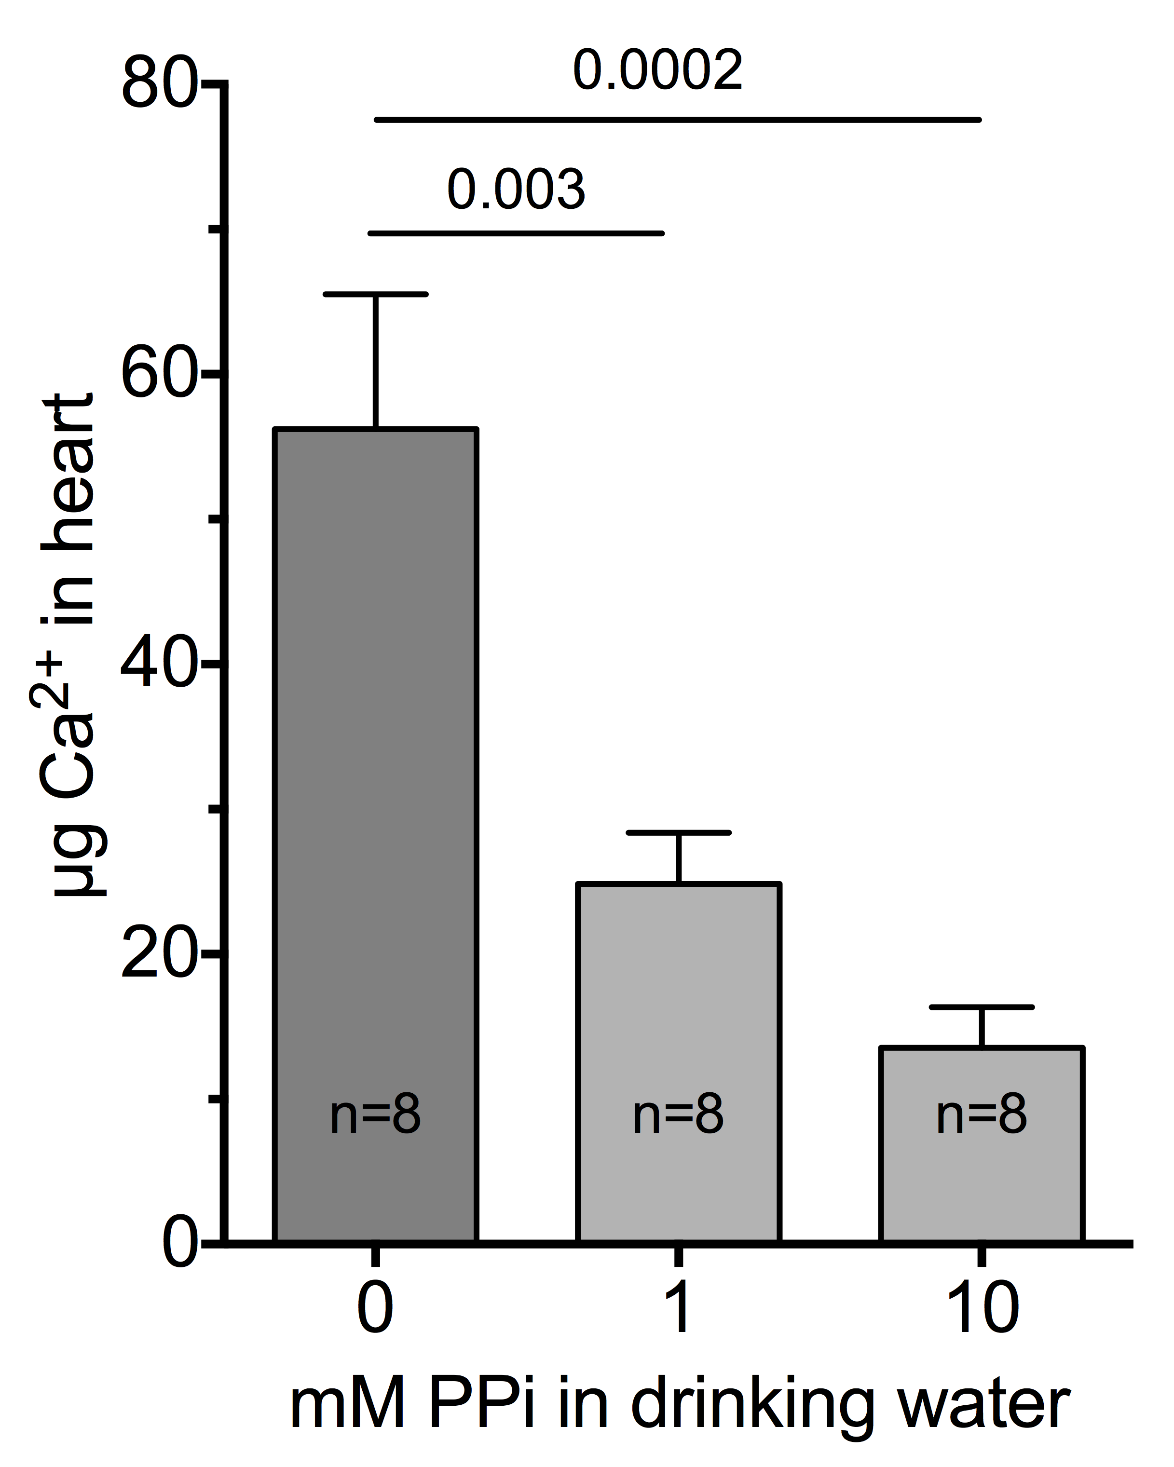
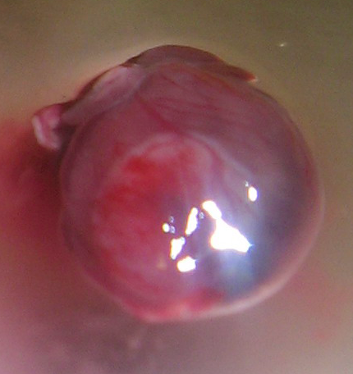
Oral PPi attenuates the provoked calcification of heart in Abcc6^{-/-} mice
Alizarin Red staining for calcium
untreated
*
10mM PPi
*
Dedinszki et al, 2017, EMBO Mol.Medicine

Slide 19
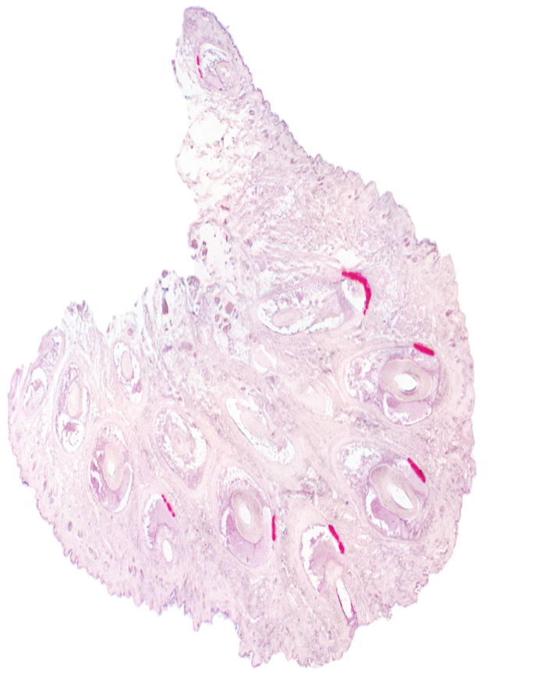
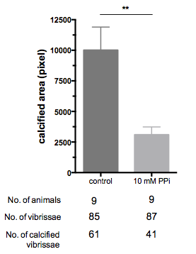
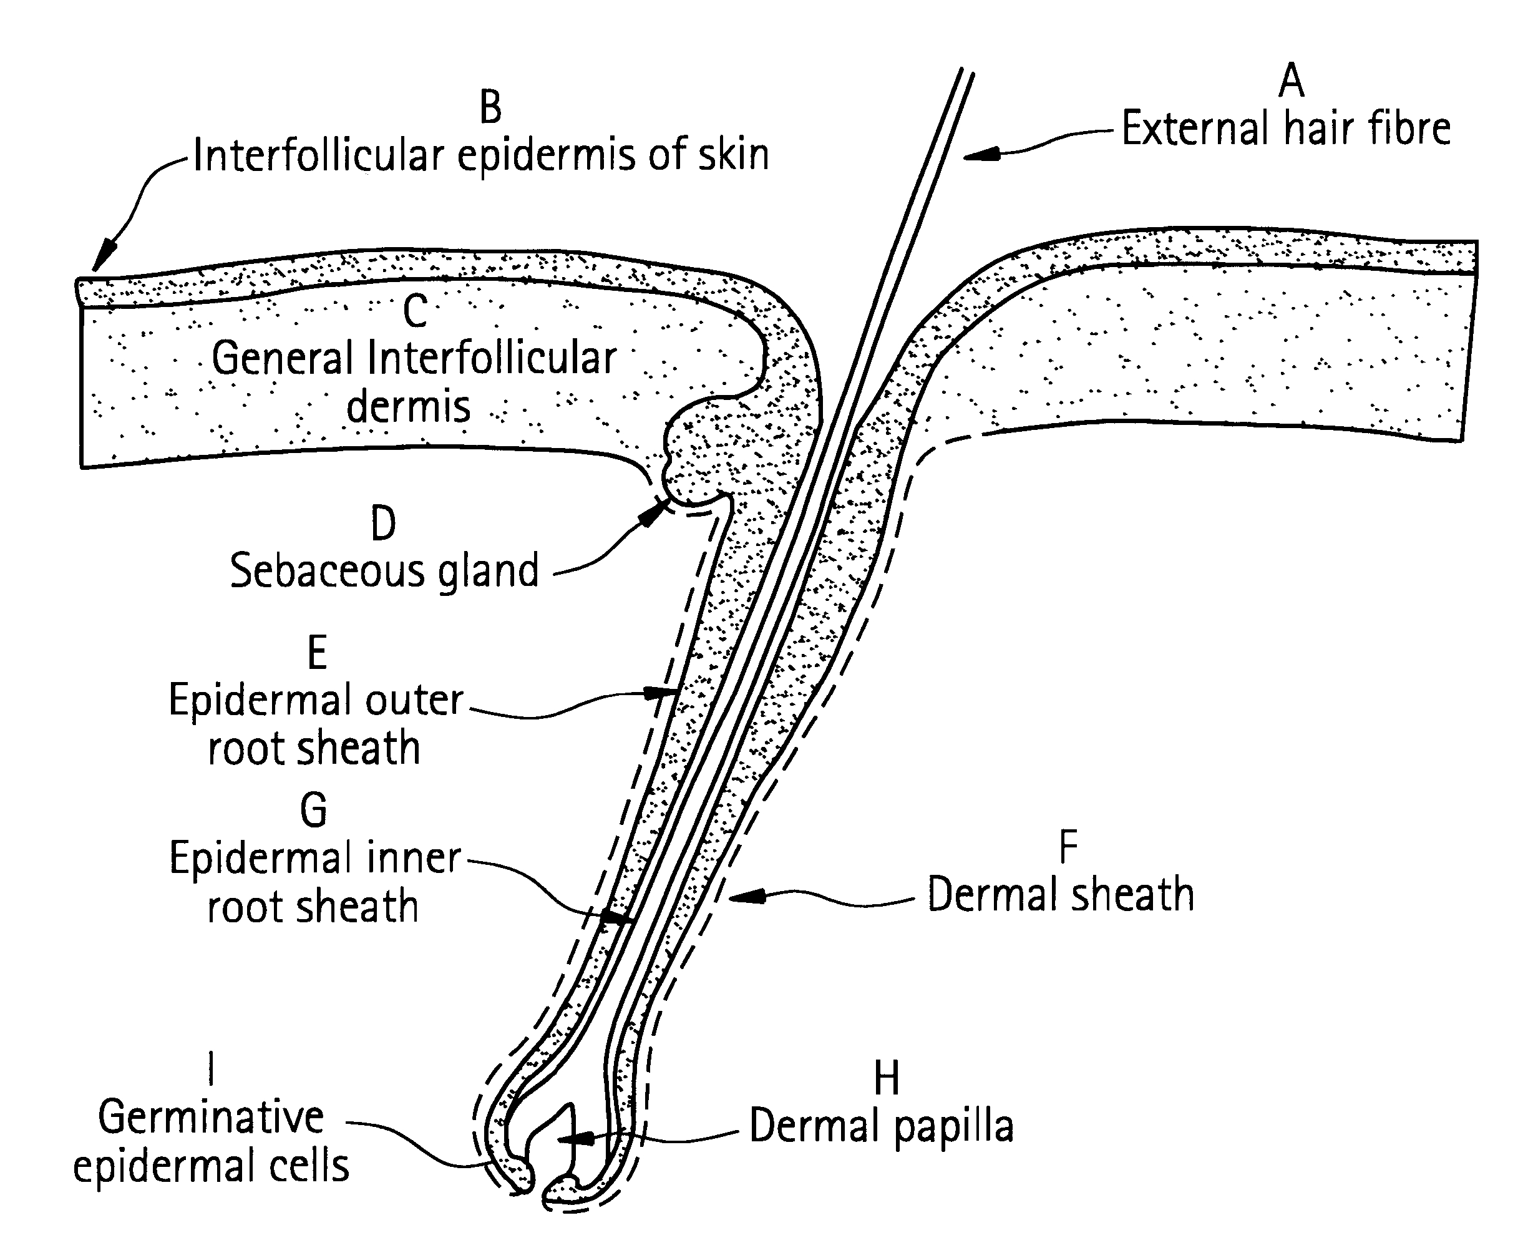
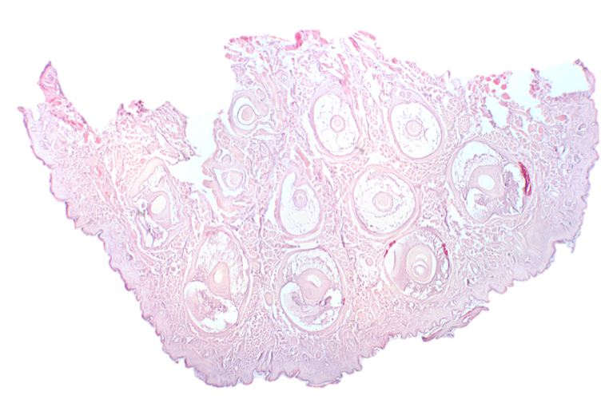
Oral PPi attenuates the spontaneous hair capsule calcification of vibrissae in
Abcc6^{-/-} mice
control
Abcc6^{-/-} mice were kept on 10mM PPi (in drinking water) starting at age 3 weeks (after weaning) until they were 22 weeks old. The control group was drinking tap water.
10 mM
PPi

Slide 20
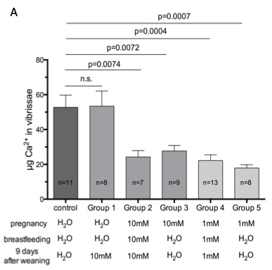
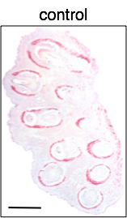
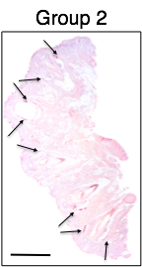
Oral PPi treatment during pregnancy attenuates the hair capsule calcification of vibrissae in
Enpp1^{-/-} mice
Dedinszki et al, 2017, EMBO Mol.Medicine

Slide 21
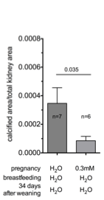
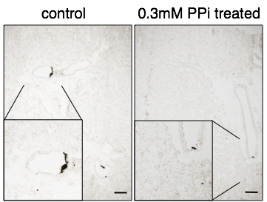
Kidney arteries
Oral PPi treatment during pregnancy
Dedinszki et al, 2017, EMBO Mol.Medicine

Slide 22
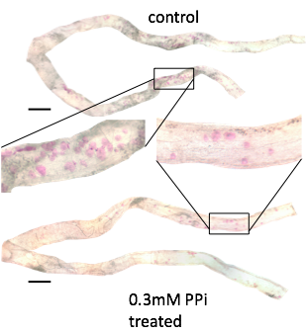
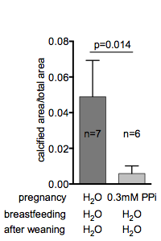
Hind limb arteries
Oral PPi treatment during pregnancy
Dedinszki et al, 2017, EMBO Mol.Medicine

Slide 23
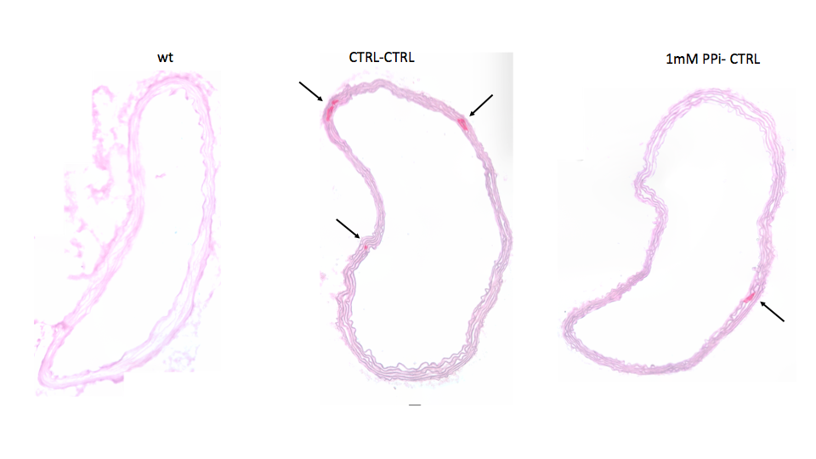

Slide 24
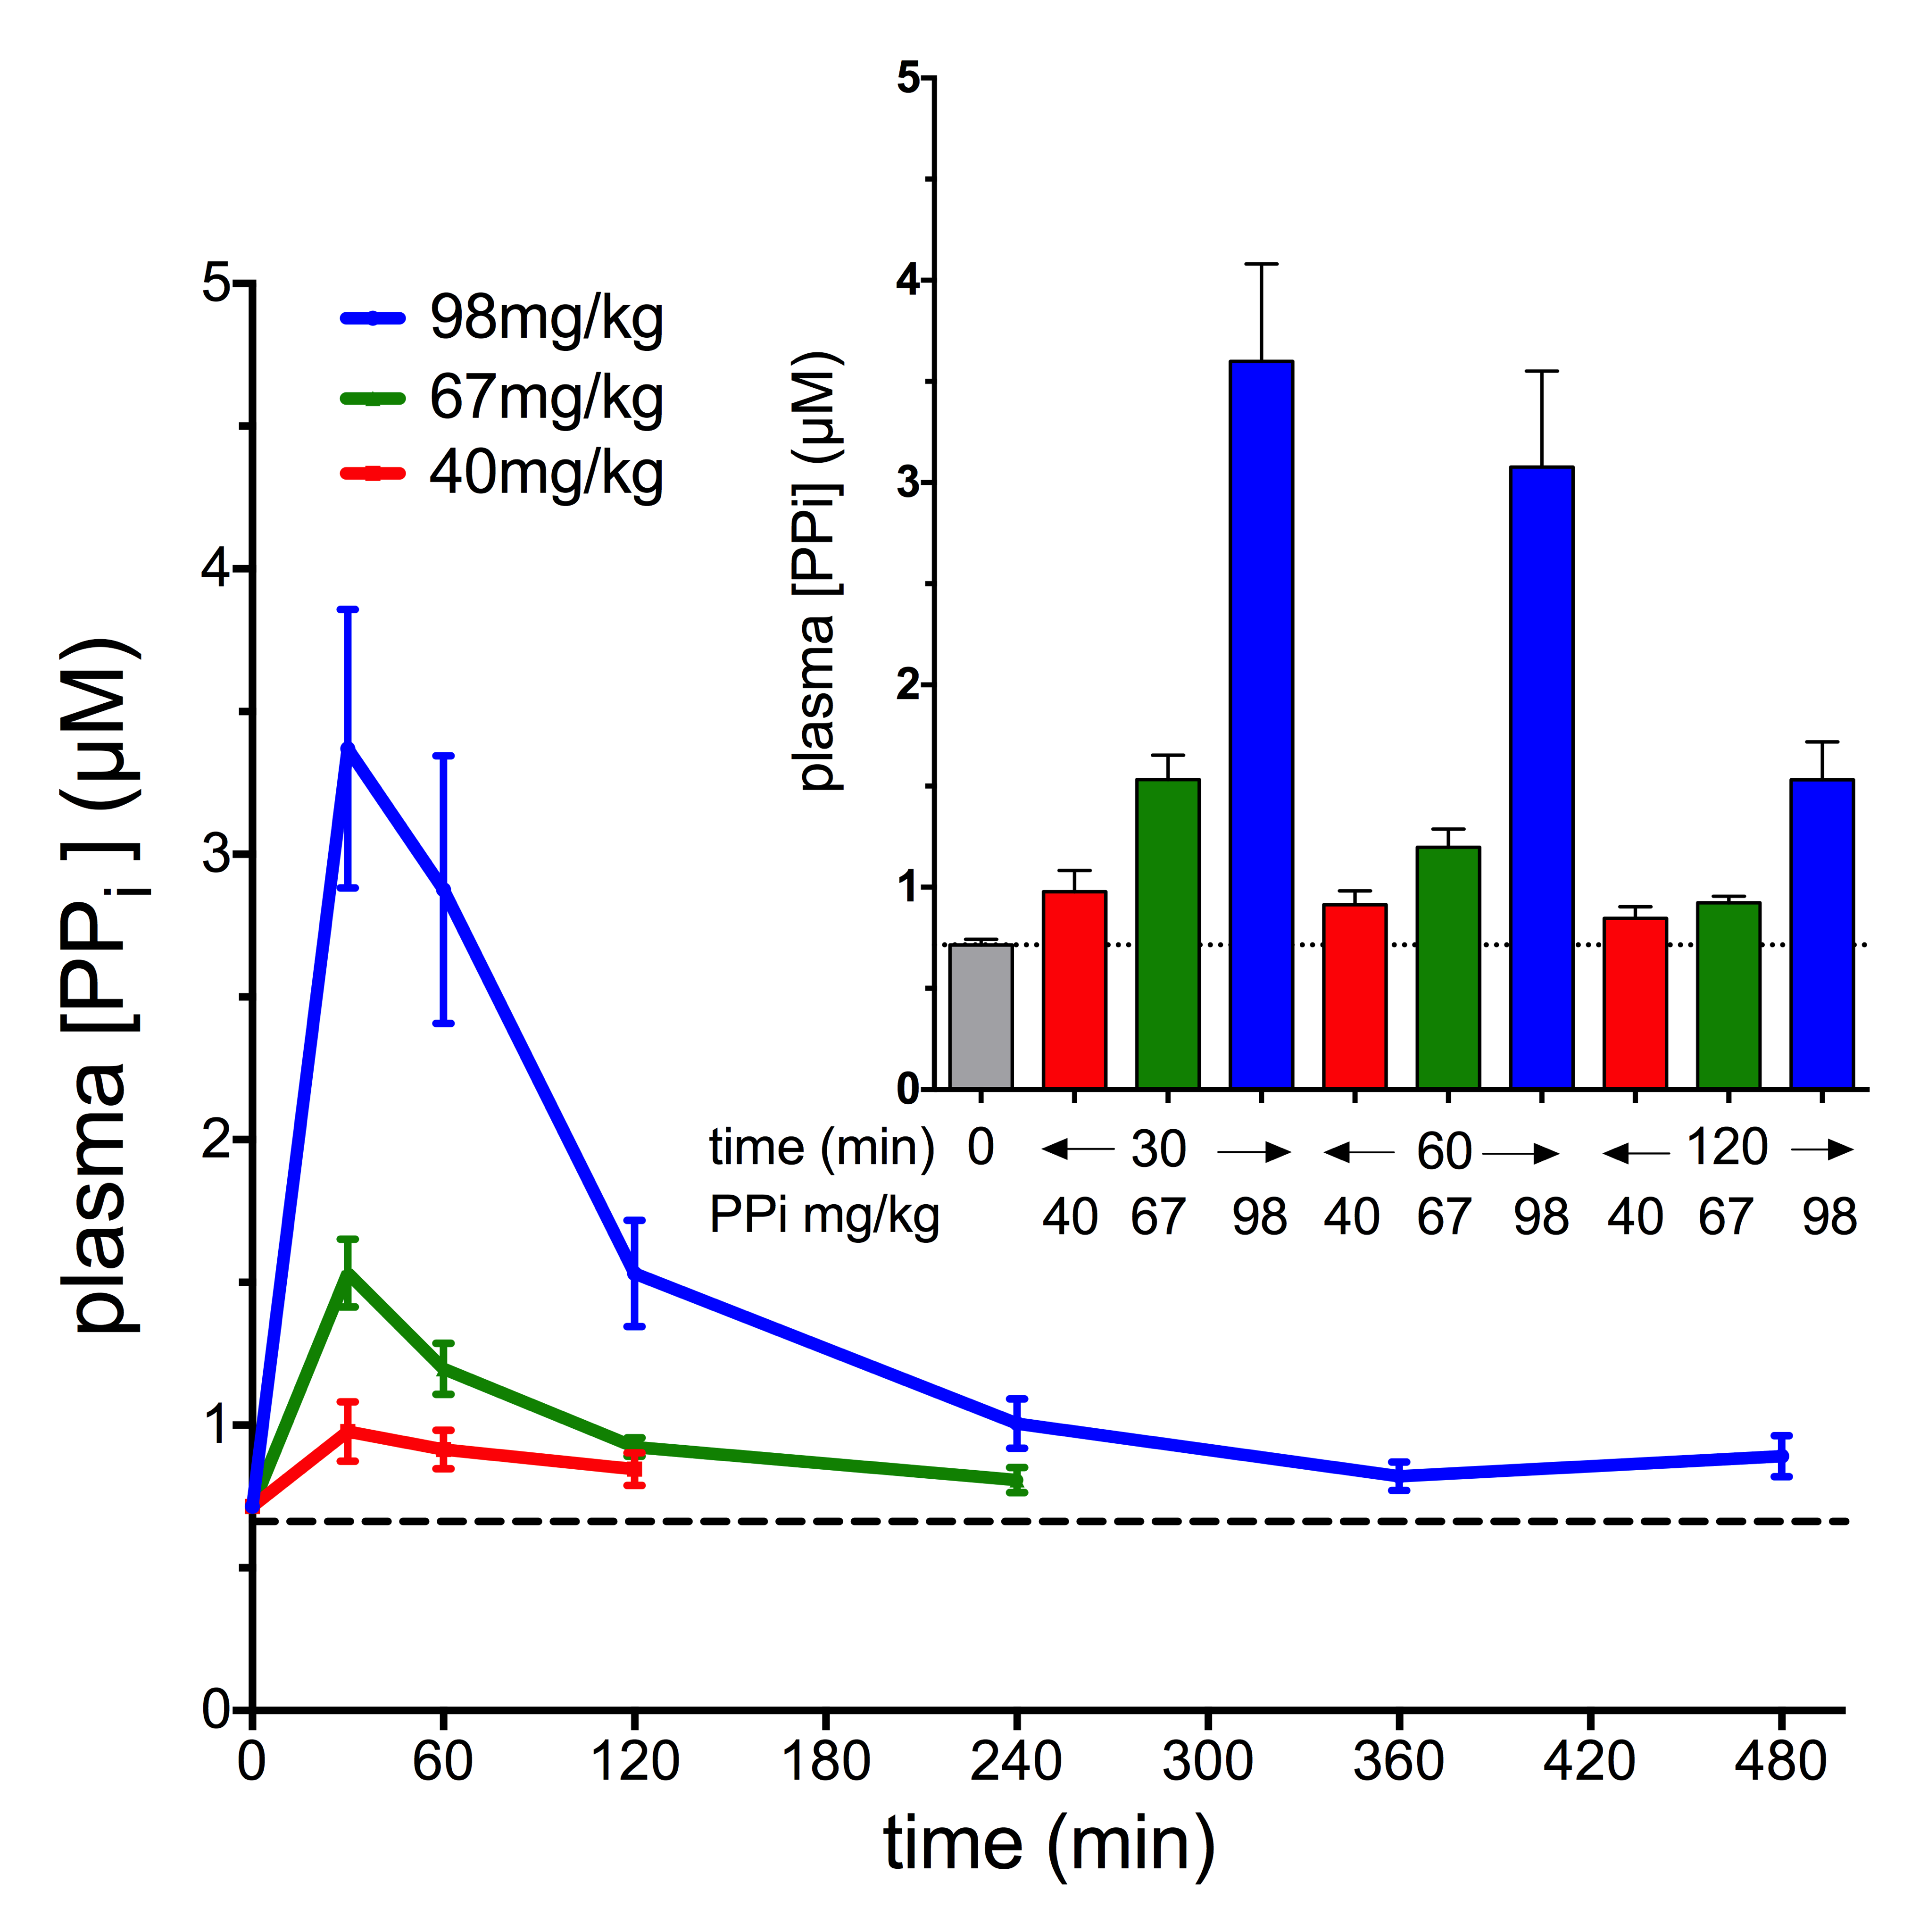
Absorption of
PPi upon oral delivery
in human
tmax = 36.7 +/- 13.2 min,
Cmax= 3.9 +/-1.6 microM
t1/2 = 44.7 +/-16.7 min
(single exponential decay)
Elevation of plasma
PPi would restore
to normal in both
GACI and PXE
Dedinszki et al, 2017, EMBO Mol.Medicine

Slide 25
Oral bioavailability
Is oral PPi substitution therapy possible?
As life-long treatment is necessary, the preferred route of administration would be oral.
HOWEVER
„…pyrophosphate has to be injected as it is ineffective orally because of hydrolytic destruction within the gut…“
Orriss, IR., Arnett, TR., Russell, RG. Pyrophosphate: a key inhibitor of mineralisation. Curr Opin Pharmacol. 28, 57-68 2016.
„However pyro- and polyphosphates …are not active when given orally…“
Francis, MD, Russell R. G. G and Fleisch,H. Diphosphonates Inhibit Formation of Calcium Phosphate Crystals in vitro and Pathological Calcification in vivo Science, 165, 1264-1266 1969
YES!
Oral PPi has potential in the treatment of connective tissue calcification disorders.
The risk of oral PPi to patients is probably negligible. Its Code for Federal Regulation by the FDA states: “This substance is generally recognized as safe when used in accordance with good manufacturing practice.”
As a first step of a clinical trial absorption of PPi in PXE patients will be studied soon in the PXE Center of Excellence, Philadelphia
NO!

Slide 26
Dóra Dedinszki
Flóra Szeri,
Viola Pomozi
Eszter Kozák
Natalia Tőkési
Emmanuel Letavernier
Olivier Le Saux
Tamás Arányi
Koen van de Wetering
,*
Piet Borst
Balázs Sarkadi
Gergely Szakács
Krisztina Fülöp
Hungarian grants OTKA
NIH
PXE International

